Slide 1


International Conference on
“Global Convergence in Technology, Entrepreneurship, Computing and Value Engineering: Principles and Practices” (ICGCP—2024)
27th – 29th April 2024
“Cardiovascular Disease Risk Prediction Using
Machine Learning”
by
Preetham S G Sapthagiri College of Engineering
Santhosh D Sapthagiri College of Engineering
Shravan L Sapthagiri College of Engineering
Vivan Kushal Heneger Sapthagiri College of Engineering
Sapthagiri College of Engineering
(Affiliated to VTU, Belagavi, Approved by AICTE New Delhi)
An ISO 9001-2015 &14001-2015 certified institute
Accredited by NAAC with ‘A’ Grade & NBA Accredited [ECE, ME, EEE, CSE, ISE]

Slide 2
Contents
Abstract
Introduction
Literature Review
Materials & Methods
Results & Discussions
Conclusions
Acknowledgements
References

Slide 3
Abstract
Improved diagnosis of cardiovascular disease and detection of high risk patients enabled by developing and evaluating an ensemble machine learning approach using logistic regression, decision trees, random forest, KNN, Naive Bayes, SVM and neural network models combined in a Quine McCluskey binary classification ensemble.

Slide 4
Introduction
The term ‘‘Heart Disease’’ (HD) is used to refer to a variety of pathological disorders that have an impact on the heart and blood vessels. It encompasses a variety of heart-related conditions, including but not limited to vascular diseases and disturbances in heart rhythm.

Slide 5
Literature Review
Sl. No. | Title | Author | Year | Contributions & Drawbacks
1 | Effective Heart Disease Prediction Using Hybrid Machine Learning Techniques | C. G. D. S. E. Silva | 2019 | Contribution: It improving the accuracy in the prediction of cardiovascular disease. Drawbacks: It consume more time to execute. It is suitable only for binary classification, i.e cannot classify stages of heart disease
2 | HDPM: An Effective Heart Disease Prediction Model for a Clinical Decision Support System | T. Hauer | 2020 | Contribution: It improving the accuracy up to 98% in the prediction of cardiovascular disease. Drawbacks: It is suitable only for binary classification, i.e cannot classify stages of heart disease.

Slide 6
Sl. No. | Title | Author | Year | Contributions & Drawbacks
3 | Efficient Medical Diagnosis of Human Heart Diseases Using Machine Learning Techniques With and Without GridSearchCV | P. Ghosh, S. Azam and M. Jonkman, A. Karim | 2022 | Contribution: It is to develop a unique model-creation technique for solving real-world problems. Drawbacks: It is suitable only for binary classification, i.e cannot classify stages of heart disease.
4 | An Efficient Prediction Method for Coronary Heart Disease Risk Based on Two Deep Neural Networks Trained on Well-Ordered Training Datasets | S. Bashir | 2022 | Contribution: It is giving 90%, Efficient Drawbacks: •It is suitable only for binary classification, i.e cannot classify stages of heart disease.

Slide 7
Materials
HARDWARE REQUIREMENTS
System : Intel I5.
Hard Disk : 120 GB.
Monitor : 15’’ LED
Input Devices : Keyboard, Mouse
Ram : 8 GB
SOFTWARE REQUIREMENTS
Operating System : Windows 64-bit
Technology : Python 3.6
IDE : Vs-code
Tools : Anaconda

Slide 8
MODULES DESCRIPTION
Data Collection:
This project utilizes a benchmark dataset that are publicly available in open repository. Several ongoing research studies utilize the Cleveland dataset from the University of California (UCI) as a standard to predict coronary heart disease.

Slide 9
Data Preprocessing:
To ensure optimal performance and accuracy in ML, preprocessing is a crucial step that involves cleaning and preparing data before it is fed into a model for training.
Feature Extraction:
FS is a critical process in ML that involves selecting the most relevant and informative features from a dataset to enhance a model’s performance.

Slide 10
Building ML Models:
This developing relationship between ML and cardiology has the potential to improve modern techniques for prediction and move the field closer to more accurate and reliable cardiovascular risk assessment.

Slide 11
Results
Predicting the presence of risk of cardiovascular diseases with the help of some vital attributes that are collected from datasets and later on classifying into 4 different stages of heart diseases.

Slide 12
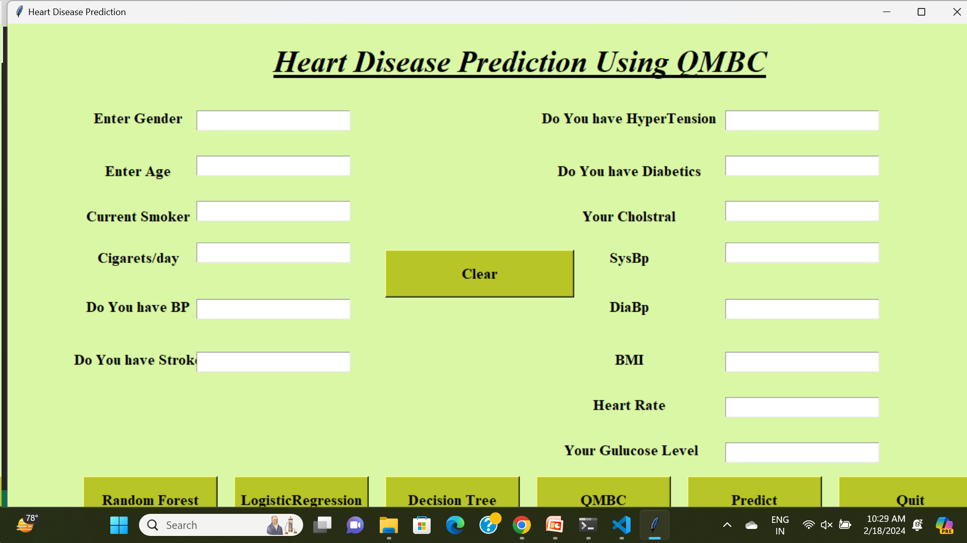

Slide 13
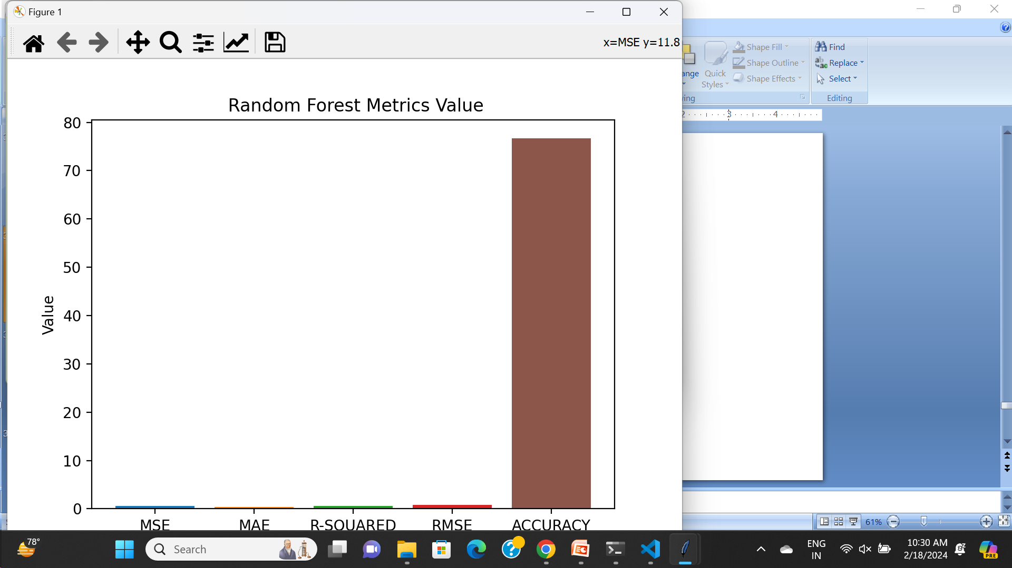
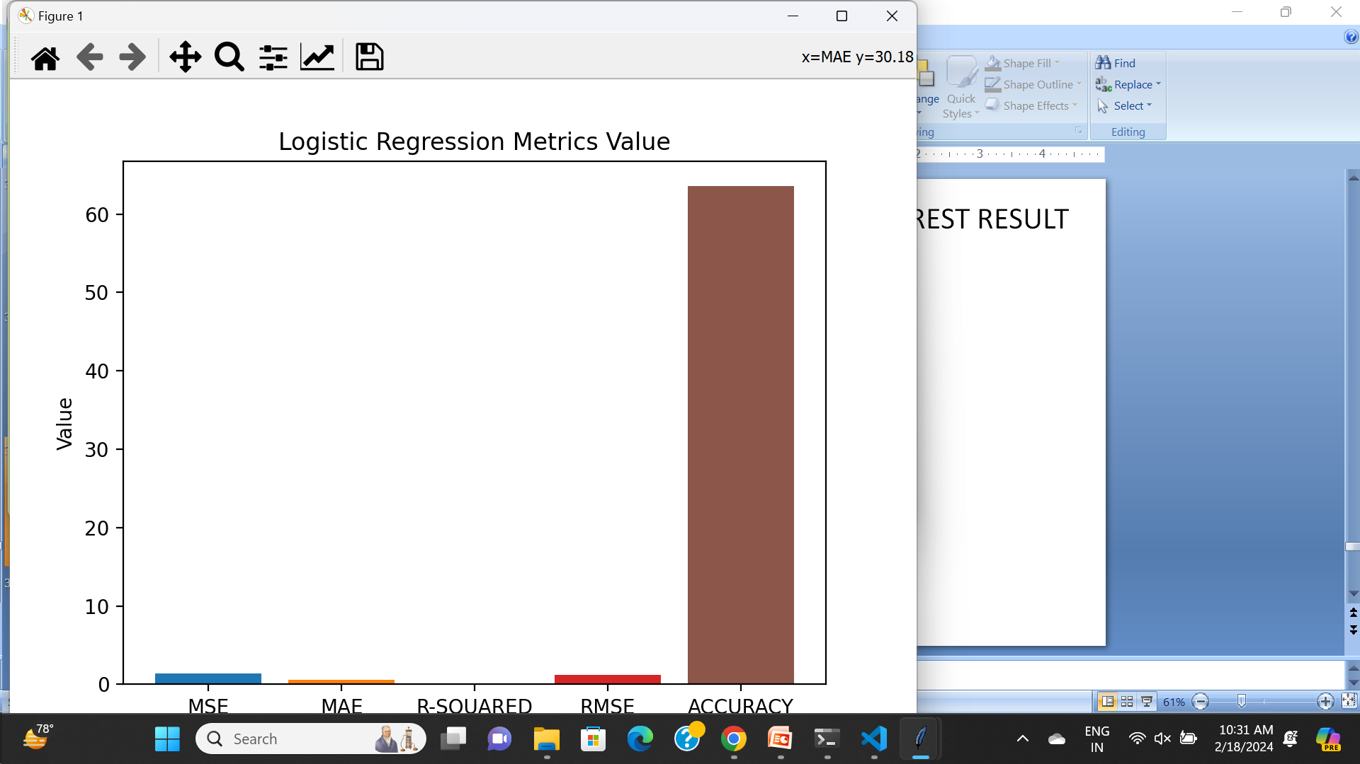

Slide 14
Conclusion
The present study investigates the performance of seven standalone ML models and a voting classifier using the Cleveland dataset
And by using the ML models and voting classifier it predicts the HD and classifies it into different stages.

Slide 15
Acknowledgement
We would like to express our sincere gratitude to the Management, Principal Sapthagiri College of Engineering Bengaluru for the facilities provided and their support. We would also like to thank the Head of department Computer Science Engineering and faculties for their encouragement and support.
Also we would like to thank our guide Prof. Shwetha K, Assistant Professor for her invaluable support and guidance.

Slide 16
References
[1] C. G. D. S. E. Silva, G. C. Buginga, E. A. D. S. E. Silva, R. Arena, C. R. Rouleau, S. Aggarwal, S. B. Wilton, L. Austford, T. Hauer, and J. Myers, “Prediction of mortality in coronary artery disease: Role of machine learning and maximal exercise capacity,” Mayo Clinic Proc., vol. 97, no. 8, pp. 14721482, Aug. 2022.
[2] M. M. Nishat, F. Faisal, I. J. Ratul, A. Al-Monsur, A. M. Ar-Rafi, S. M. Nasrullah, M. T. Reza, and M. R. H. Khan, “A comprehensive investigation of the per- formances of different machine learning classifiers with SMOTE-ENN oversampling technique and hyperparame- ter optimization for imbalanced heart failure dataset,” Sci. Program., vol. 2022, pp. 1–17, Mar. 2022.
[3]WorldHealthOrganization.(2009).CardiovascularDiseases(CVDS).[Online].Available:http://www.who.int/mediacentre/factsheets/fs317/en/index.html
[4] M. Ozcan and S. Peker, “A classification and re- gression tree algorithm for heart disease modeling and prediction,” Healthcare Anal., vol. 3, Nov. 2023

